Slide 1

EDA-AMCAT DATA ANALYSIS

Slide 2
About me
I’m Rishitha Rumandla pursuing B.Tech branch Computer Science and Artificial Intelligence & Machine Learning.
I find data science fascinating because it combines analytical skills with creativity to uncover insights from data. It’s all about making informed decisions and solving real-world problems. The ability to analyze patterns, predict trends, and visualize information can significantly impact various fields, from healthcare to finance. Plus, the constant evolution of tools and techniques keeps things exciting and challenging!
GitHub: https://github.com/RishithaRumandla24

Slide 3
Description of Data Set
The dataset contains the employment outcomes of engineering graduates as dependent variables (Salary, Job Titles, and Job Locations) along with the standardized scores from three different areas – cognitive skills, technical skills and personality skills.
. The dataset contains around 40 independent variables and 4000 data points. The independent variables are both continuous and categorical in nature.

Slide 4
Problem Statement
The main idea of the project of EDA –AMCAT Data Analysis :
To remove the null values and replace the values by mean and mode.
Find the outliers of the data.
Univariate Analysis -> PDF, Histograms, Boxplots, Count plots, etc.. understand the probability and frequency distribution of each numerical column understand the frequency distribution of each categorical Variable/Column
Bivariate Analysis->Discover the relationships between numerical columns using Scatter plots, hex bin plots, pair plots, etc. Identify the patterns between categorical and numerical columns using swarm plot, boxplot, bar plot, etc. .Identify relationships between categorical and categorical columns using stacked bar plots.

Slide 5
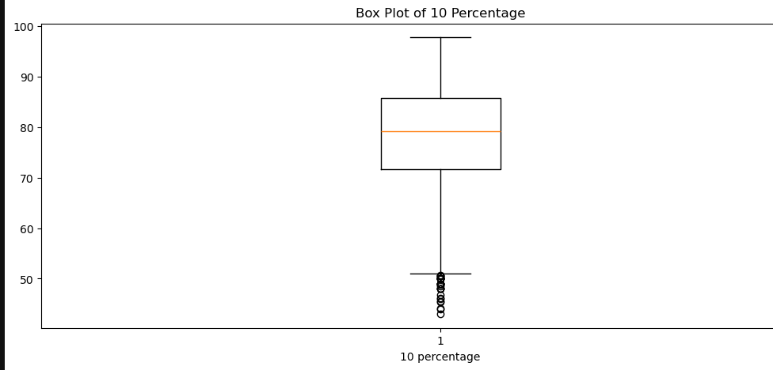
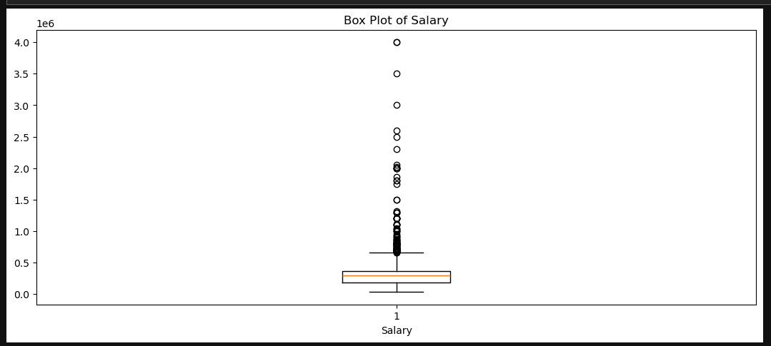
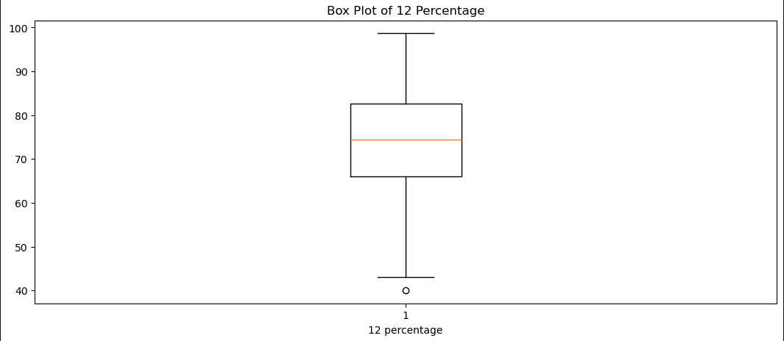
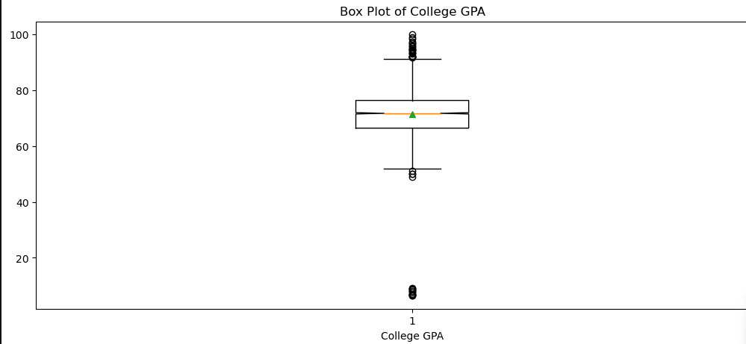
Univariate Analysis

Slide 6
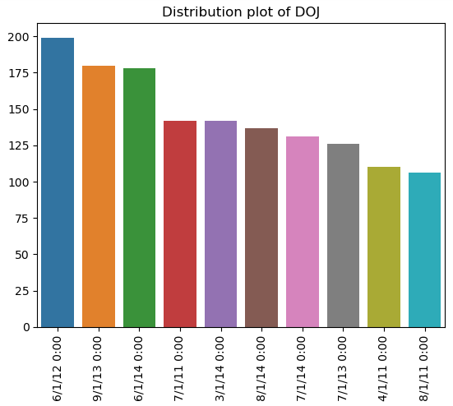
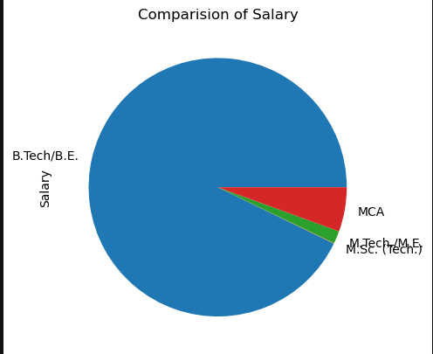

Slide 7
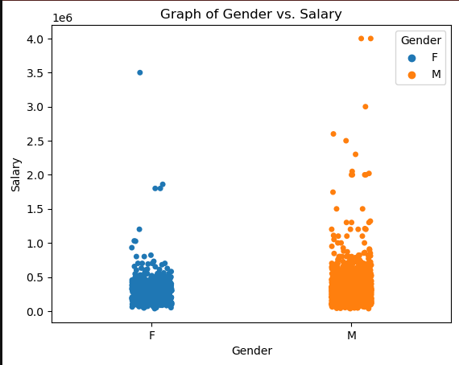
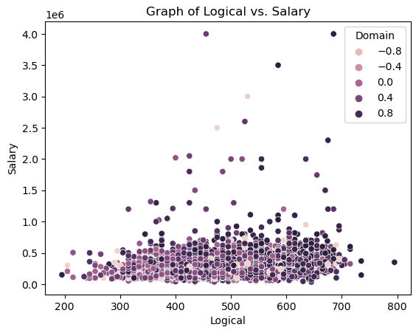
Bivariate Analysis

Slide 8
Conclusion
The exploratory data analysis highlights significant insights regarding salary distributions and the influence of educational specialization and gender on earnings. Key findings include:
A notable positive correlation between experience and salary.
Higher average salaries for graduates in Computer Science.
Gender disparities in specialization preferences, particularly in engineering fields.

Slide 9

THANK YOU

